Slide 2
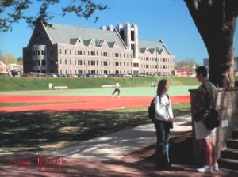
Mandeville Hall, St. Joseph’s University, Philadelphia

Slide 3
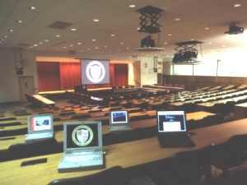
The Teletorium

Slide 4


Slide 5
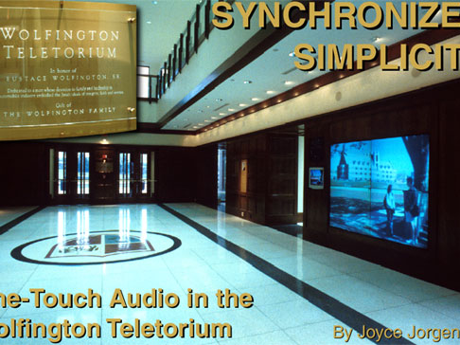
Simple?

Slide 6
Farber, J. 1998. “The Third Circle: On Education and Distance Learning”, Sociological Perspectives 41(4): 797-814.
3
2
1
Circle 1: measurable competence
Circle 2: competence
Circle 3: education

Slide 7
What does Farber mean by “education”? Based on the findings in Pascarella and Terenzini (1991), he writes:
“College-educated persons are likely to be less authoritarian and dogmatic, to have greater flexibility of thought and tolerance for ambiguity, and to have made some gains in psychosocial adjustment and in the sense of well-being. They are likely to show a preference for reflective and abstract thought and for problem-solving approaches that are logical, rational, and critical. They are likely to have greater interest in aesthetic, cultural, and intellectual subjects, and in public affairs and politics. They are likely to attach more importance to education, to place more value on intrinsic occupational rewards, and to have more egalitarian views of gender roles. They are somewhat more likely to demonstrate a social conscience and humanitarian values and to support civil rights and liberties. Finally, they are more likely to engage in principled moral reasoning” (ibid. p. 800).
Pascarella , Ernest T. and Patrick Terenzini. 1991. How College Affects Students. San Francisco: Jossey-Bass

Slide 8
University: I. 1. a. The whole body of teachers and scholars engaged, at a particular place, in giving and receiving instruction in the higher branches of learning; such persons associated together as a society or corporate body, with definite organization and acknowledged powers and privileges (esp. that of conferring degrees), and forming an institution for the promotion of education in the higher or more important branches of learning; also, the colleges, buildings, etc., belonging to such a body (OED)

Slide 9
(This slide not meant to be a good example of PowerPoint!)
Nozar and Wilson (2007) results: (612 econ students)
- Students clearly preferred chalk and talk saying it improves student involvement with course, increases student-teacher interaction.
- At-risk students do get more from technology than high-performing students.
-Among upper division students, and those who have had 4 or more classes, the preference for “chalk and talk” was even more compelling. They’re bored in PPT discussions.
-Over 90% of students say the lecturing skill of the instructor is important to their learning outcome.
-”Chalk and talk” is good for both engagement and achievement. It does not correlate with passive learning and student disengagement.
-The real danger is that technology can “interfere with the learning process” if universities take technology-intensive instruction more seriously than developing faculty lecturing skills.
*Would your department hire anyone who gave a “chalk and talk” sample lecture, even in light of this research?
Nozar, Hashemzadeh and Loretta Wilson. 2007. Teaching with the lights out: what do we really know about the impact of technology intensive instruction? College Student Journal 41(3): 601-612

Slide 10
Closing Questions:
1. Do you feel that the campus fosters a healthily critical attitude towards educational technology?
2. How can we achieve both aims of education, access to everyone and to “the life of the mind” at CSUN? Should we indeed make the effort or do we need to choose?
3. How can we improve and assess online classes to provide the richest sort of education?

